Slide 1

Software Migration
Notes:
Good morning everyone, my name is Alexander and I am studying in a master degree of Computer Science
excited to talk about a topic related to my studies that I find interesting: „Software Migration“.
Everyone is using software, nowadays even people‘s life is relying on software. We all use for example this smart device every day which is full of software.
But did you know that organisations are often relying and maintaining outdated Software?
This is like using and relying on trains which are build in the 1970s, like the SWB is doing

Slide 2
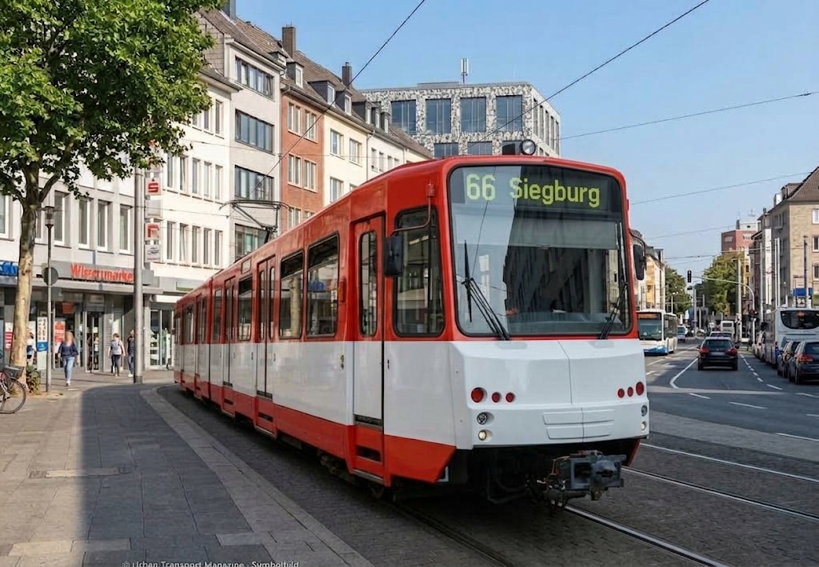
Software Migration
SWB
Notes:
You perhaps noticed that the SWB recently had to take out most of their trams ouf of service
Maybe some of you including me exprencied the effect, more time to travel between Bonn and University, full busses and more stress because the replacement service is not working properly
The main problem is that SWB is relying on Trams which are build in the 1970/80s.
Instead of ordering step-by-step new Trams they kept in repairing the old trams again and again.
Organisations are facing similar problems in regard to software

Slide 3
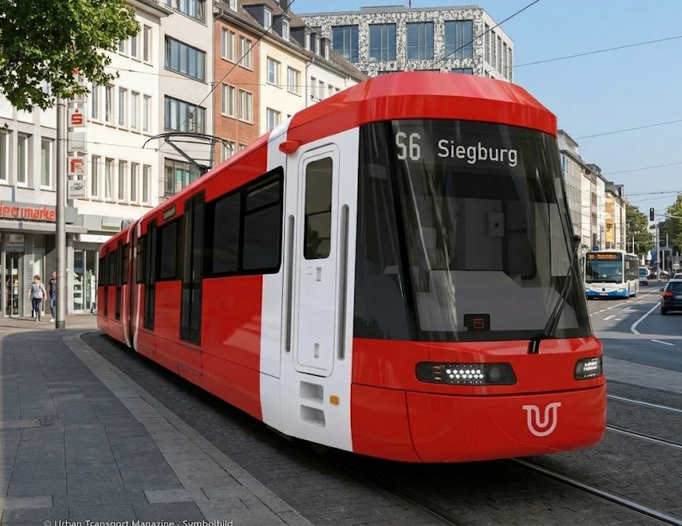
Software Migration
SWB
Notes:
Software Migration is exactly dealing with the question: How can we transform old software into new Software.
So today, I would like to explain you what Software Migration means and why it is relevant
If you have any further questions please note them down and keep them until the end of my talk. I will be open for questions afterwards.

Slide 4
Outline
Definition of Software Migration
Big Bang Migration
Strangler Pattern
Notes:
So, first I want to explain you the definition of software migration
Then, I want you explain the Term Big Bang Migration
And in the end we will look on the Strangler Pattern, which might be the SWB‘s longterm solution for their Tram problem

Slide 5
Software Migration
Definition (Wagner, 2014):
  Splitting and transferring software to a new platform or technology
Notes:
Splitting and transferring software to a new platform or technology
Goal: meet new requirements and improve future maintanability
Existing functionality is to be preserved in order to prevent the loss of business knowledge

Slide 6
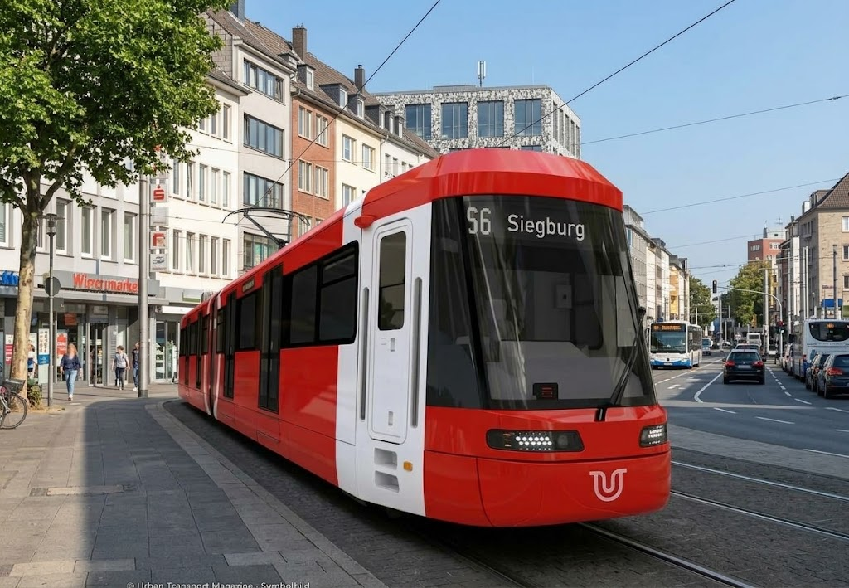
Software Migration
Definition (Wagner, 2014):
  Splitting and transferring software to a new platform or technology
Approaches:
  Big Bang Migration: The new system is developed separately and if done the old system will be replaced
Notes:
Big Bang Migraation: A completely new system is separately developed. If it is done it will replace the old system
In order to do this, you have to fully understand the old system which might not be given leading to…

Slide 7

Software Migration
Definition (Wagner, 2014):
  Splitting and transferring software to a new platform or technology
Approaches:
  Big Bang Migration: The new system is developed separately and if done the old system will be replaced
    Risks:
      Huge cost and time effort
      Parts of the company may not be fully operational
      New Software is outdated again on completion
Notes:
Risks:
… huge time effort
You must maintain two systems leading to huge costs
You have the risk that during or after the transitional phase parts of the company may not be operational or not working properly
Risk that new software is outdated on completion again

Slide 8

Software Migration
Definition (Wagner, 2014):
  Splitting and transferring software to a new platform or technology
Approaches:
      Strangler Pattern:
Notes:
Strangler Pattern:
“To strangle” means that something is slowly wrapping around something else until it becomes overtaken.
Here in this image, we can see, that the vines will by time cut off light and the nutrition supply of the big tree, so that it will die. Only the strangler vines will remain.
We want our transition from the old towards the new system in a similar kind of way

Slide 9
Software Migration
Definition (Wagner, 2014):
  Splitting and transferring software to a new platform or technology
Approaches:
      Strangler Pattern: Step-by-step replacement of the old software
Old System
Strangler Facade
Strangler Facade
New System
Old System
New System
Old System
New System
Notes:
Strangler Pattern: The new System is strangling the old system step-by-step
As we can see here the old system is incrementally replaced by the new system
During the Migration Process the System have to provide an Facade routing function calls to the right system
We see that parts of the old system is incrementally integrated into the new system.
By time the new system strangle the old system like the vines of the tree until the old system is completely migrated
Personally, I would recommend SWB to use the Strangler Pattern to incrementally renew their fleet, which they might already planning

Slide 10
References
Alda, S. (n.d.). Migration von Software – eine allgemeine Einführung. Lecture of Object-Oriented Component Architectures (OOKA) Renamed to Service-Oriented Component Architectures (SEKA). Lecture of Object-Oriented Component Architectures (OOKA).
Wagner, C. (2014). Model-Driven Software Migration: A Methodology: Reengineering, Recovery and Modernization of Legacy Systems. Springer Fachmedien Wiesbaden. https://doi.org/10.1007/978-3-658-05270-6
Google Gemini AI for creating images. https://gemini.google.com/
Notes:
Thats it what I wanted to share with you today about Software Migration. Of course you can dive more deeper into to topic, but I want to let like this for today
As references I used one lecture of my master degree and this paper for the definition of Software Migration
I used Google Gemini to support my presentation with pictures

Slide 11
Thank you for your attention !!
I am now open for questions.
Notes:
I appreciate your attenetion
I am now open and looking forward for your questions

